Slide 1
Data Structures and algorithms RECURSION
SADIA ZAR

Slide 2
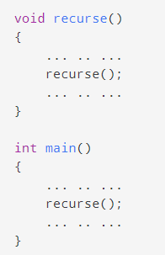
RECURSION – DATA STRUCTURE
A function that calls itself is known as a recursive function. And, this technique is known as recursion.
Working of Recursion in C++

Slide 3
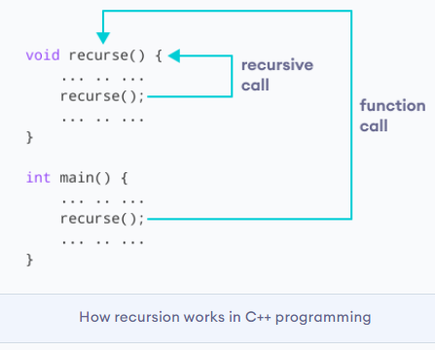
RECURSION – DATA STRUCTURE
The figure below shows how recursion works by calling itself over and over again.

Slide 4
RECURSION – DATA STRUCTURE
The recursion continues until some condition is met.
To prevent infinite recursion, if...else statement (or similar approach) can be used where one branch makes the recursive call and the other doesn't.

Slide 5
RECURSION – DATA STRUCTURE
Direct recursion vs indirect recursion
Direct recursion: When function calls itself, it is called direct recursion, the example we have seen above is a direct recursion example.
Indirect recursion: When function calls another function and that function calls the calling function, then this is called indirect recursion. For example: function A calls function B and Function B calls function A.

Slide 6
RECURSION – DATA STRUCTURE
#include <iostream>
using namespace std;
int fa(int);
int fb(int);
int fa(int n)
{
if(n<=1)
return 1;
else
return n*fb(n-1);
}
int fb(int n)
{
if(n<=1)
return 1;
else
return n*fa(n-1);
}
int main()
{
int num=5;
cout<<fa(num);
return 0;
}

Slide 7
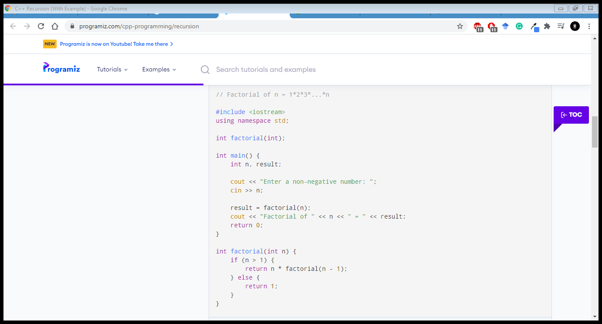
RECURSION – DATA STRUCTURE
Example 1: Factorial of a Number Using Recursion

Slide 8
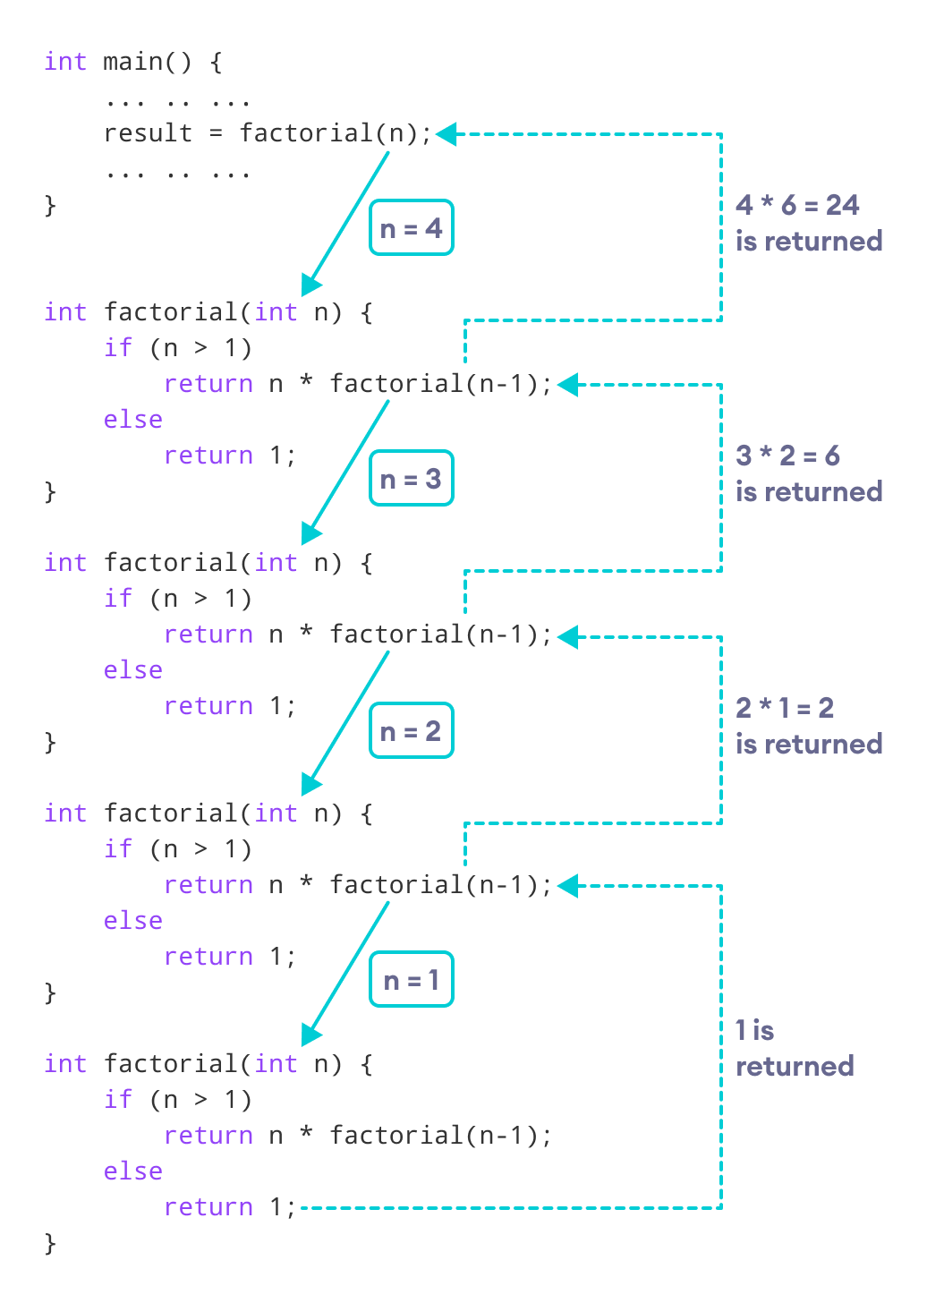
Working of Factorial Program
As we can see, the factorial() function is calling itself. However, during each call, we have decreased the value of n by 1. When n is less than 1, the factorial() function ultimately returns the output.

Slide 9
RECURSION – DATA STRUCTURE
Advantages of C++ Recursion
It makes our code shorter and cleaner.
Recursion is required in problems concerning data structures and advanced algorithms, such as Graph and Tree Traversal.
Disadvantages of C++ Recursion
It takes a lot of stack space compared to an iterative program.
It uses more processor time.
It can be more difficult to debug compared to an equivalent iterative program.

